Slide 1
How can we increase revenue
from
Catch the Pink Flamingo?
To Phung Huy

Slide 2
Problem Statement
How to use the following data sets to explore revenue increasing strategies?
Useful Datasets | Their roles
Buy-clicks.csv (1) | Main dataset - 1st level revenue info
Ad-clicks.csv (2) | Can be combined with (1) for insights on conversions
User-session.csv | Users’ in-game behaviors
Game-clicks.csv | Users’ in-game behaviors
Chat-data package | Contains inter-user interactions info. Important for PR-related analytics
Notes:
The first two datasets (1) , (2) are important datasets to derive revenue related information. Dataset 2 can be combined with dataset 1 to derive various ad conversion rate.
To increase revenue one can either increase customers’ total spendings or ad conversion rates. This is because, for in-app purchases ads: higher conversion rates equals higher profit, while for third party ads, higher conversion rates provide better leverage to charge the advertisers more
We can use the next two datasets to find relationships between a user’s in-game behaviors and their spendings or conversion rate. Such strategy, of combining multiple datasets to draw insights, is at the heart of data science.
The insights obtained can allow us to increase revenue by tailoring different sales/marketing strategies to different groups of users based on in-game behaviors
Last but not least, exploration of the chat data can allow us to design better PR or more effective marketing strategy. This can have an indirect effect on increasing revenue

Slide 3
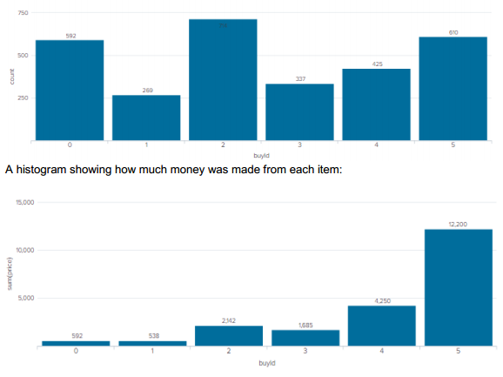
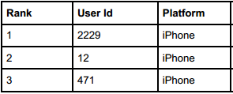
Data Exploration Overview
Item 5 = current money spinner
Item 4 = potential money spinner → focus
Top payers all I-phone users?
Histogram showing buy count for each item
Notes:
Brief explorations of revenue data show us that Item 5 is our most effective money making machine.
If it is an in-game item, we should maintain current marketing strategy.
If it is an item from third party app, however, then it’s time to charge higher advertising fee or raise the commission rates
Item 4 can also be another potential money spinner for us, provided that we implement some strategies NOW to boost sales of this item.
Details about top 3 spenders hints at I-phone users being more generous spenders. True or not? This needs more explanation

Slide 4
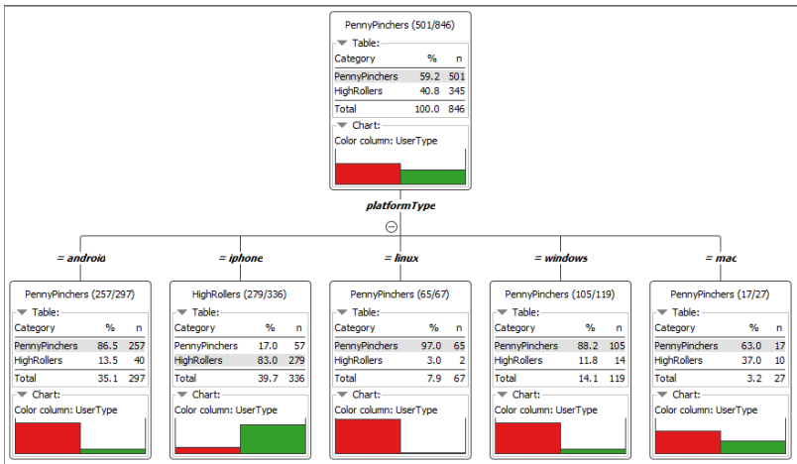
What have we learned from classification?
I-phone users truly do pay more
More marketing to these users
Notes:
The classification result shows that I-phone users are High Rollers who spend on average more than 5 dollars per purchase
Other platforms’ users are Penny Pinchers who spend on average 5 dollar of less per purchase
This prediction model predicts the correct spender class of user 88.5% of the time
To increase revenue, we should target third-party ads of more expensive items (to get higher commissions) or more epensive in-game items to I-phone users
We can also send them vouchers & tailored thank you emails to encourage them to maintain this behavior
On the other hand, we can introduce more promotions to other platforms’ users

Slide 5
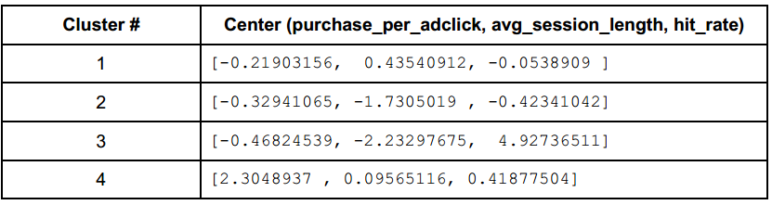
What have we learned from clustering?
We can segment our players into 4 groups
C1 – game lovers – longest play time
C2 – least skillful – worst hit rate
C3 – assassins – extremely skillful, efficient & frugal
C4 – willing spenders – our target demographic
Notes:
To increase revenue we should tailor specific sales/marketing strategy to each group (cluster) of users
Game lovers spend the most time playing → they should be seeing more ads compared to others → target more ads to them
Least skillful heave the lowest hit rate among the group → We should target ads about hit-rate-promoting in-app items to them
Assassins spend the least & play the game using shortest session length → we should present only ads about promotional packages or combo purchases
Last group are willing spenders. These are our target milk cow group. We should target more ads of more expensive products to these users
If we target third party ads to these users, we should charge the advertisers more or take higher commissions

Slide 6
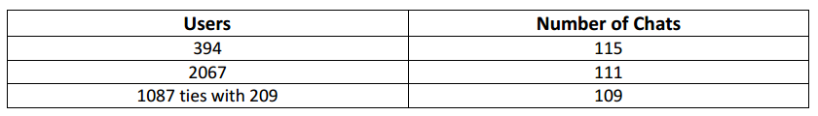
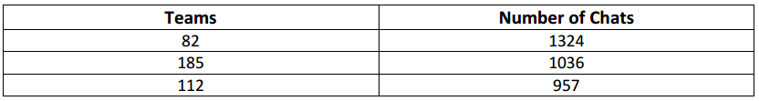
From our chat graph analysis, what further exploration should we undertake?
We have identified chattiest users & teams (only top 3 shown here)
We have also identified most active user clusters
Further possible actions
Determine sentiment with NLP
Determine least/never purchased items & chattiest user
in each cluster
Notes:
We have already identified chattiest users and teams (there are 10 each category but I only presented top 3 here)
We have also identified the top dense communities (group of users who frequently interact with one another) in the graph
We can perform further exploration such as
Using NLP analytics on the chat text to see what most chattiest people think about the game. Are they happy/frustrated? Are there aspects they want improvements in? These people are most likely to voice their opinions out to other people so it is important to track what they are saying. If we don’t do this bad sentiment about the game can spread → users can leave → revenue drops
For each dense communities, we can perform more analytics of what items have never been/are rarely bought and either
Find the chattiest user & market only to him/her and hope the marketing can spread by word of mouth to his/her friends in the cluster → save ad cost but still effective
Market to users in same cluster with ads starting with “Your friends x, y also buy … “. The friends x,y come from same cluster

Slide 7
Recommendation
More than one recommendations for Egglence to increase revenue!
Focus on item id 4 – potential money spinner
Targeted luxury item marketing to I-phone users. Also charge 3rd party advertiser more to target this demographic
Specialized marketing strategies to different user groups arising from suggested 4-group clustering
PR-analytics of game sentiment via chats from chattiest users
Innovative marketing from knowledge of dense
user communities
Notes:
This slide will summarize all the recommendations I have so far on how the company can increase its revenue
There are 5 recommeded actions to increase revenue
Please refer to slide for all 5 recommendations

